Slide 1
Faculty: INFORMATION TECHNOLOGY Department: Information Management| Networks and Communications Systems| Software Engineering INSY 8212:Programming with C

Slide 2
Module contents
Introduction to computers
Types of programming languages
Introduction to C
Features of C
Compilers
Running C programs.
Define Character set, identifiers and keywords, variables, declaring variables, data types, displaying variables, reading variables, constants

Slide 3
AUCA, Quiz1/10pts, 7/10/2024, Gr.Mond 18h00
Q1. With example differentiate printf and scaf /3pts
Q2. The score in Math:18/20, Programing:16/20, engish:13/20, display the value of variables, avg, sum. If avg is greater than 18, display Grad A, if avg is greater than 16, and less than 18, display Grad B, other cases display Grad C /4pts
Q3. Differentiate ternary operators and bit level operators (bitwice) with example /3pts

Slide 4
AUCA, Quiz1/10pts, 8/10/2024, Gr.Tuesday 18h00
Q1. write a program to calculate the value of x which is an int data type.
X=23/4*6+3*29%5-2*47%7 /2.5pts
Q2. Write a program to check if the number is even or odd number /2.5pts
Q3. with example differentiate if else and ternary operator /2.5pts
Q4. Write a program to show how do while loop can be an infinite loop by using encrementation and decrementation /2.5pts

Slide 5
Single character input - single character output- scanf function, writing output data - the printf function
Arithmetic operators, relational operators, logical operators, bitwise operators, comma operator, conditional operator.

Slide 6
If statement, if-else statement, switch statement. Loops, for loop, while loop, do while loop, break statement, continue statement, goto statement
Operations on array
Array illustrations
Multi-dimensional arrays
Strings
Defining a function, recursion.
Defining a structure
Uses of pointers

Slide 7
Introduction to computers
A computer is an electronic device that processes data and performs tasks according to a set of instructions called a program. It can store, retrieve, and process information, making it a powerful tool for various applications.

Slide 8
Here are some basic components and functions of a computer:
Central Processing Unit (CPU): Often called the "brain" of the computer, the CPU performs calculations and executes instructions.
Memory (RAM): Random Access Memory (RAM) temporarily stores data that the CPU needs while performing tasks. It is fast but volatile, meaning it loses its data when the computer is turned off.

Slide 9
Storage: Computers use various forms of storage to retain data long-term. Hard drives (HDDs) and solid-state drives (SSDs) are common types of storage devices.
Input Devices: These include keyboards, mice, and other devices that allow users to input data into the computer.

Slide 10
Output Devices: Monitors, printers, and speakers are examples of devices that output data from the computer in a usable form.
Operating System (OS): This is the software that manages the hardware and software resources of the computer, providing a user interface and managing applications.

Slide 11
Computers come in various forms, including personal computers (PCs), laptops, tablets, and servers. They are essential in many fields, from business and education to entertainment and scientific research.

Slide 12
Servers
Servers are specialized computers designed to manage, store, and process data for multiple users or systems over a network. Unlike personal computers, which are typically used by one person at a time, servers provide services and resources to many users simultaneously. They play a crucial role in networks, data centers, and cloud computing environments.

Slide 13
Types of programming languages
Programming languages come in many types, each designed for different kinds of tasks. Here's a broad overview of some key categories:
Low-Level Languages:
Machine Language: The most basic form of programming language, consisting of binary code that a computer's CPU directly executes.
Example: binary code ; 6= 110, 1 ( 2² ) + 1 ( 2¹ ) + 0 ( 2⁰ )

Slide 14
Cont…
Assembly Language: A human-readable representation of machine code, using pre-defined word called mnemonics for operations and addresses. It’s specific to a computer’s architecture.
Example: Add A, B

Slide 15
2. High-Level Languages:
Object-Oriented Languages: Focus on objects and classes to organize code.
C++: An extension of C that includes object-oriented features.
Java: Known for its portability across platforms, thanks to the Java Virtual Machine (JVM).
Python: Emphasizes readability and ease of use, with support for multiple programming paradigms.

Slide 16
What is C?
C is a high-level, procedural programming language developed in the early 1970s by Dennis Ritchie at Bell Labs. It has influenced many other programming languages and remains widely used today for systems programming, embedded systems, and application development due to its efficiency and control over system resources.

Slide 17
Key Features of C:
Simplicity: C provides a relatively small set of keywords and constructs, which helps in understanding and mastering the language.
Efficiency: C allows for direct manipulation of hardware and memory, providing high performance and control.

Slide 18
Cont…
Portability: Programs written in C can be compiled and run on different types of computer systems with minimal modification.
Rich Set of Operators: C supports a wide variety of operators for mathematical, logical, and bitwise operations.

Slide 19
Cont…
Structured Programming: C promotes structured programming by supporting functions, allowing code to be organized into modules for better readability and maintenance.
Standard Library: C provides a standard library of functions for performing common tasks, such as input/output operations, string manipulation, and mathematical computations.

Slide 20
Compilers
In the world of computer programming, the C Compiler plays a crucial role in transforming human-readable code into an executable form for computers to understand.

Slide 21
Source code
The source code is typically written in a high-level, human-readable language such as Java or C++.
A programmer writes the source code in a code editor or an integrated development environment (IDE) that includes an editor, saving the source code to one or more text files.
A compiler that supports the source programming language reads the files, analyzes the code, and translates it into a format suitable for the target platform.

Slide 22
Running C programs.
C language Tutorial with programming approach for beginners and professionals, helps you to understand the C language tutorial easily.
The C Language is developed by Dennis Ritchie for creating system applications that directly interact with the hardware devices such as drivers, kernels, etc. C programming is considered as the base for other programming languages, that is why it is known as mother language.

Slide 23
Basic Syntax and Concepts:
Hello, World! Program:
#include <stdio.h>
int main() {
printf("Hello, World!\n"); return 0;
}
#include <stdio.h>: Includes the Standard Input Output library needed for printf.
int main(): The main function where execution starts.
printf(): A function used to output text to the console.
return 0;: Indicates successful completion of the program

Slide 24
Character set in C
A character set is a collection of all characters (like letters, digits, symbols, etc.) that can be used in code. It is classified into two main categories: the source character set and the execution character set in C.

Slide 25
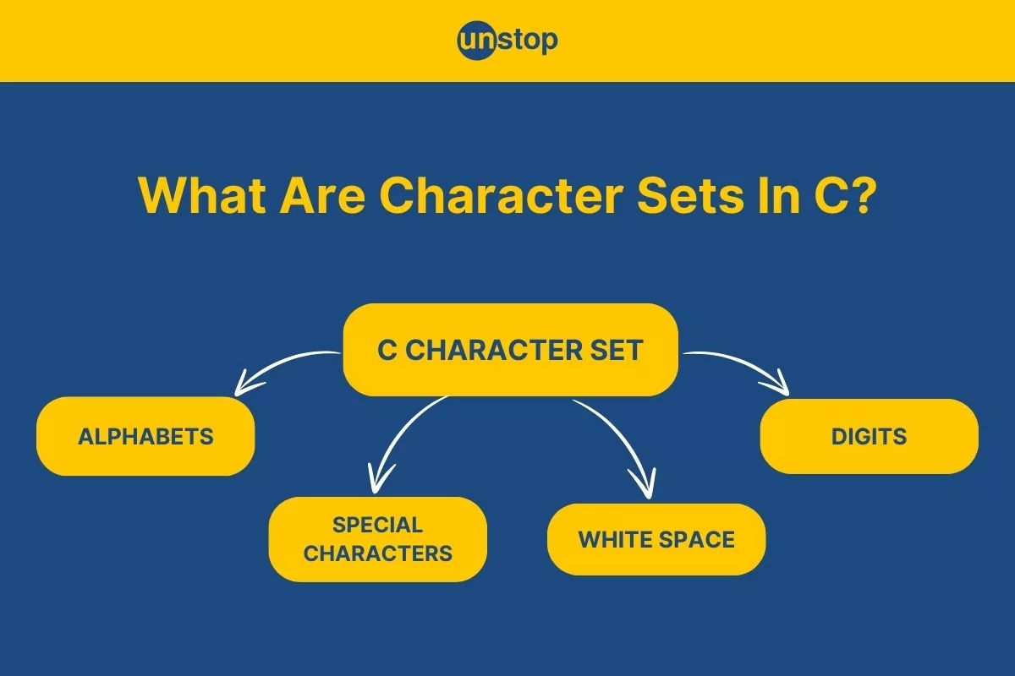

Slide 26
The source character set
In the C programming language, the character set refers to a set of all the valid characters that we can use in the source program for forming words, expressions, and numbers. The source character set contains all the characters that we want to use for the source program text.

Slide 27
Execution Character Set (ECS):
The execution character set is the encoding/programming used for the text of your program that is input to the compilation phase after all preprocessing steps. This character set is used for the internal representation of any string or character literals/accurates in the compiled code.

Slide 28
Identifiers and Keywords
In C programming, identifiers and keywords play crucial roles in the structure and syntax of the code. Here's a detailed look at each:
Identifiers
Identifiers are names given to various program elements such as variables, functions, arrays, etc. They allow you to refer to these elements in your code. Here are the key rules and characteristics of identifiers in C:

Slide 29
1. Rules for Identifiers:
Start with a Letter or Underscore: Identifiers must begin with a letter (uppercase or lowercase) or an underscore (_). They cannot start with a digit.
Followed by Letters, Digits, or Underscores: After the first character, identifiers can include letters, digits, and underscores.

Slide 30
Cont…
Case Sensitivity: Identifiers are case-sensitive. For example, Variable, variable, and VARIABLE would be considered different identifiers.
No Reserved Keywords: Identifiers cannot be the same as C keywords

Slide 31
2. Examples of Valid Identifiers:
Count
total_sum
MAX_VALUE
myVariable1

Slide 32
Examples of Invalid Identifiers:
1variable (starts with a digit)
total sum (contains a space)
int (reserved keyword)

Slide 33
Keywords
Keywords are reserved words that have special meaning in C and cannot be used as identifiers.
They are part of the language's syntax and serve specific purposes.
Each keyword is used to define the structure and behavior of the code.

Slide 34
1. List of C Keywords:
Data Types: int, char, float, double, void
Control Flow: if, else, switch, case, default, break, continue, return
Storage Classes: auto, register, static, extern
Modifiers: signed, unsigned, long, short
Logical Operators: &&, ||, !
Others: sizeof, typedef, struct, union, enum, goto, const, volatile, restrict

Slide 35
2. Examples of Keywords in Use:
#include <stdio.h>
int main() { int count = 10;
// 'int' is a keyword for integer data type if (count > 5) { //
'if' is a keyword for conditional statements printf("Count is greater than 5.\n");
} return 0;
// 'return' is a keyword used to exit the function }

Slide 36
Summary
Identifiers: Used to name variables, functions, arrays, etc. Must follow specific naming rules and cannot be the same as keywords.
Keywords: Reserved by the language for specific syntactical functions. They cannot be used as identifiers and have predefined meanings in the C language.
Understanding and correctly using identifiers and keywords is fundamental to writing effective and error-free C programs.

Slide 37
Variables
In programming, we often need a named storage location to store the data or values. Using variables, we can store the data in our program and access it afterward.
Variables are containers for storing data values, like numbers and characters.

Slide 38
Cont…
In C, there are different types of variables (defined with different keywords), for example:
int - stores integers (whole numbers), without decimals, such as 123 or -123
float - stores floating point numbers, with decimals, such as 19.99 or -19.99
char - stores single characters, such as 'a' or 'B'. Characters are surrounded by single quotes

Slide 39
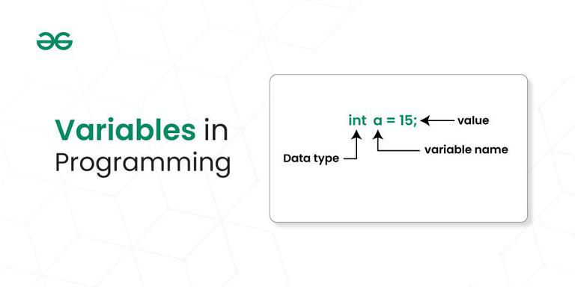

Slide 40
Declaration of Variable in Programming
In programming, the declaration of variables involves specifying the type and name of a variable before it is used in the program. The syntax can vary slightly between programming languages, but the fundamental concept remains consistent.
To create a variable, specify the type and assign it a value:

Slide 41
Syntax
type variableName = value;
Where type is one of C types (such as int), and variableName is the name of the variable (such as x or myName). The equal sign is used to assign a value to the variable.
Example
Create a variable called myNum of type int and assign the value 15 to it:
int myNum = 15;

Slide 42
Cont…
You can also declare a variable without assigning the value, and assign the value later:
Example
// Declare a variable
int myNum;
// Assign a value to the variable
myNum = 15;

Slide 43
Example
#include <stdio.h>
int main()
{
// Syntax: datatype variable_name;
int age;
double price;
char grade;
return 0;
}

Slide 44
Initialization of Variable in Programming:
Initialization of variables In Programming involves assigning an initial value to a declared variable. The syntax for variable initialization varies across programming languages.

Slide 45
Example
#include <stdio.h>
int main()
{
// Declaration and Initialization
int age = 25;
double price = 10.99;
char grade = 'A';
return 0;
}

Slide 46
Data types
Each variable in C has an associated data type. It specifies the type of data that the variable can store like integer, character, floating, double, etc.
Each data type requires different amounts of memory and has some specific operations which can be performed over it.
The data type is a collection of data with values having fixed values, meaning as well as its characteristics.

Slide 47
Cont…
The data type specifies the size and type of information the variable will store.
In this tutorial, we will focus on the most basic ones:
Data Type | Size | Description | Example
int | 2 or 4 bytes | Stores whole numbers, without decimals | 1
float | 4 bytes | Stores fractional numbers, containing one or more decimals. Sufficient for storing 6-7 decimal digits | 1.99
double | 8 bytes | Stores fractional numbers, containing one or more decimals. Sufficient for storing 15 decimal digits | 1.99
char | 1 byte | Stores a single character/letter/number, or ASCII values | 'A'

Slide 48
Basic Format Specifiers
There are different format specifiers for each data type. Here are some of them:
Format Specifier | Data Type
%d or %i | int
%f or %F | float
%lf | double
%c %s | Char string

Slide 49
Cont…
Note: It is important that you use the correct format specifier for the specified data type, or the program may produce errors or even crash.

Slide 50
Displaying variables
The C library printf() function is a fundamental tool for outputting formatted text to the standard output stream. It allows for versatile printing of variables, strings, and other data types.

Slide 51
Cont…
The syntax of the C Printf function is as follows: printf("format string", argument1, argument2, ...);
The format string contains the text along with the format specifiers that should be replaced with the values provided in the argument list.
Example:int age = 25; printf("Your age is: %d", age);

Slide 52
Reading variables
The scanf() function is a commonly used input function in the C programming language. It allows you to read input from the user or from a file and store that input in variables of different data types.
Input is an essential part of most programs, and the scanf() function provides an easy way to read input in a variety of formats.

Slide 53
Scanf()format
The most common conversion specifiers are:
%d: reads an integer value
%f: reads a floating-point value
%c: reads a single character
%s: reads a string of characters
%lf: reads a double-precision floating-point value

Slide 54
Example:
For example, the following code reads an integer value and a floating-point value from the user, and stores them in the variables num and fnum, respectively:

Slide 55
Cont…
#include <stdio.h>
int main() {
int num;
float fnum;
printf("Enter an integer and a floating-point number: ");
scanf("%d %f", &num, &fnum);
printf("You entered %d and %f\n", num, fnum);
return 0;
}

Slide 56
Cont…
In this example, the format string "%d %f" tells scanf() to read an integer value followed by a floating-point value, separated by a space.
The & operator is used to pass the address of the num and fnum variables to scanf(), so that the input values can be stored in those variables.

Slide 57
Arithmetic operators
Arithmetic Operators are the type of operators in C that are used to perform mathematical operations in a C program. They can be used in programs to define expressions and mathematical formulas.

Slide 58
Types of Arithmetic Operators in C
The C Arithmetic Operators are of two types based on the number of operands they work. These are as follows:
Binary Arithmetic Operators
Unary Arithmetic Operators

Slide 59
Binary Arithmetic Operators in C
The C binary arithmetic operators operate or work on two operands. C provides 5 Binary Arithmetic Operators for performing arithmetic functions which are as follows:

Slide 60
Operator | Name of the Operator | Arithmetic Operation | Syntax
+ | Addition | Add two operands. | x + y
– | Subtraction | Subtract the second operand from the first operand. | x – y
* | Multiplication | Multiply two operands. | x * y
/ | Division | Divide the first operand by the second operand. | x / y
% | Modulus | Calculate the remainder when the first operand is divided by the second operand. | x % y

Slide 61
Example of Binary Arithmetic Operator in C
// C program to demonstrate syntax of binary arithmetic
// operators
#include <stdio.h>
int main()
{
int a = 10, b = 4, res;
// printing a and b
printf("a is %d and b is %d\n", a, b);
res = a + b; // addition
printf("a + b is %d\n", res);
res = a - b; // subtraction
printf("a - b is %d\n", res);
res = a * b; // multiplication
printf("a * b is %d\n", res);
res = a / b; // division
printf("a / b is %d\n", res);
res = a % b; // modulus
printf("a %% b is %d\n", res);
return 0;
}

Slide 62
Output
a is 10 and b is 4
a + b is 14
a - b is 6
a * b is 40
a / b is 2
a % b is 2

Slide 63
Unary Arithmetic Operators in C
The unary arithmetic operators operate or work with a single operand. In C, we have two unary arithmetic operators which are as follows:

Slide 64
Operator | Symbol | Operation | Implementation
Decrement Operator | — | Decreases the integer value of the variable by one. | –h or h–
Increment Operator | ++ | Increases the integer value of the variable by one. | ++h or h++
Unary Plus Operator | + | Returns the value of its operand. | +h
Unary Minus Operator | – | Returns the negative of the value of its operand. | -h

Slide 65
Relational Operators in C
In C, relational operators are the symbols that are used for comparison between two values to understand the type of relationship a pair of numbers shares.
The result that we get after the relational operation is a boolean value, that tells whether the comparison is true or false.
Relational operators are mainly used in conditional statements and loops to check the conditions in C programming.

Slide 66
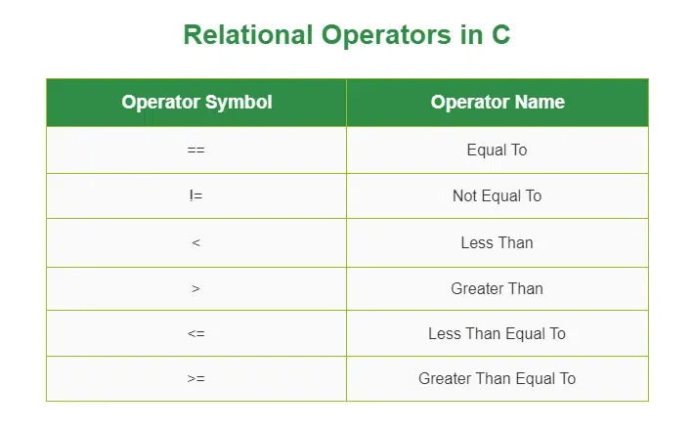

Slide 67
Equal to operator (==)
The C equal to operator (==) is a relational operator that is used to check whether the two given operands are equal or not.
Equal to operator is a binary operator hence it requires two operands to perform the comparison.
If the two values are equal, it returns true. Otherwise, it returns false.

Slide 68
Syntax
operand1 == operand2
For example, 5==5 will return true.

Slide 69
Not equal to operator (!=)
The C not equal (==) to operator is another relational operator used for checking whether the two given operands are equal or not.
It is also a binary operator, requiring two operands to perform the comparison.
It is the exact boolean complement of the ‘==’ operator which returns true if the two values are not equal, false otherwise.

Slide 70
Syntax
operand1 != operand2
For example, 5!=5 will return false.

Slide 71
Logical operators
Logical operators in C are used to combine multiple conditions/constraints. Logical Operators returns either 0 or 1, it depends on whether the expression result is true or false. In C programming for decision-making, we use logical operators.
We have 3 logical operators in the C language:
Logical AND ( && )
Logical OR ( || )
Logical NOT ( ! )

Slide 72
Types of Logical Operators
Logical AND Operator ( && )
The logical AND operator (&&) returns true only if both operands are non-zero. Otherwise, it returns false (0). The return type of the result is int. Below is the truth table for the logical AND operator.

Slide 73
X | Y | X && Y
1 | 1 | 1
1 | 0 | 0
0 | 1 | 0
0 | 0 | 0
Syntax
(operand_1 && operand_2)

Slide 74
Example
// C program for Logical
// AND Operator
#include <stdio.h>
// Driver code
int main()
{
int a = 10, b = 20;
if (a > 0 && b > 0) {
printf("Both values are greater than 0\n");
}
else {
printf("Both values are less than 0\n");
}
return 0;
}

Slide 75
Logical OR Operator ( || )
The logical OR operator returns true if any one of the operands is non-zero. Otherwise, it returns false i.e., 0 as the value. Below is the truth table for the logical OR operator.

Slide 76
X | Y | X || Y
1 | 1 | 1
1 | 0 | 1
0 | 1 | 1
0 | 0 | 0
Syntax
(operand_1 || operand_2)

Slide 77
Example
// C program for Logical
// OR Operator
#include <stdio.h>
// Driver code
int main()
{
int a = -1, b = 20;
if (a > 0 || b > 0) {
printf("Any one of the given value is "
"greater than 0\n");
}
else {
printf("Both values are less than 0\n");
}
return 0;
}

Slide 78
Logical NOT Operator ( ! )
If the given operand is true then the logical NOT operator will make it false and vice-versa. Below is the truth table for the logical NOT operator.
X | !X
0 | 1
1 | 0
Syntax
!(operand_1 && operand_2)

Slide 79
Example
// C program for Logical
// NOT Operator
#include <stdio.h>
// Driver code
int main()
{
int a = 10, b = 20;
if (!(a > 0 && b > 0)) {
// condition returned true but
// logical NOT operator changed
// it to false
printf("Both values are greater than 0\n");
}
else {
printf("Both values are less than 0\n");
}
return 0; }

Slide 80
Bitwise operators
In C, the following 6 operators are bitwise operators (also known as bit operators as they work at the bit-level).

Slide 81
C provides six operators for bit manipulation.
Symbol | Operator
& | bitwise AND
| | bitwise inclusive OR
^ | bitwise XOR (exclusive OR)
<< | left shift
>> | right shift
~ | bitwise NOT (ones' complement) (unary)

Slide 82
Bitwise AND &
bit a | bit b | a & b (a AND b)
0 | 0 | 0
0 | 1 | 0
1 | 0 | 0
1 | 1 | 1

Slide 83
Cont…
The bitwise AND operator is a single ampersand: &. It is just a representation of AND which does its work on the bits of the operands rather than the truth value of the operands.
Bitwise binary AND performs logical conjunction (shown in the table above) of the bits in each position of a number in its binary form.

Slide 84
For instance, working with a byte (the char type):
11001000
& 10111000
-------- ------
= 10001000
The most significant bit of the first number is 1 and that of the second number is also 1 so the most significant bit of the result is 1; in the second most significant bit, the bit of second number is zero, so we have the result as 0.

Slide 85
Bitwise XOR ^
bit a | bit b | a ^ b (a XOR b)
0 | 0 | 0
0 | 1 | 1
1 | 0 | 1
1 | 1 | 0
The bitwise XOR (exclusive or) performs an exclusive disjunction, which is equivalent to adding two bits and discarding the carry. The result is zero only when we have two zeroes or two ones.[3] XOR can be used to toggle the bits between 1 and 0. Thus i = i ^ 1 when used in a loop toggles its values between 1 and 0

Slide 86
11001000
^ 10111000
-------- ------
= 01110000

Slide 87
Conditional or Ternary Operator (?:) in C
The conditional operator in C is kind of similar to the if-else statement as it follows the same algorithm as of if-else statement but the conditional operator takes less space and helps to write the if-else statements in the shortest way possible. It is also known as the ternary operator in C as it operates on three operands.

Slide 88
Cont…
The conditional operator can be in the form:
variable = Expression1 ? Expression2 : Expression3;
Or the syntax can also be in this form
variable = (condition) ? Expression2 : Expression3;
Or syntax can also be in this form
(condition) ? (variable = Expression2) : (variable = Expression3);

Slide 89
Cont…
#include <stdio.h>
int main()
{
int a=5,b; // variable declaration
b=((a==5)?(3):(2)); // conditional operator
printf("The value of 'b' variable is : %d",b);
return 0;
}

Slide 90
Cont…
In the above code, we have declared two variables, i.e., 'a' and 'b', and assign 5 value to the 'a' variable. After the declaration, we are assigning value to the 'b' variable by using the conditional operator. If the value of 'a' is equal to 5 then 'b' is assigned with a 3 value otherwise 2.

Slide 91
Comma operator
In the C and C++ programming languages, the comma operator (represented by the token ,) is a binary operator that evaluates its first operand and discards the result, and then evaluates the second operand and returns this value (and type); there is a sequence point between these evaluations.

Slide 92
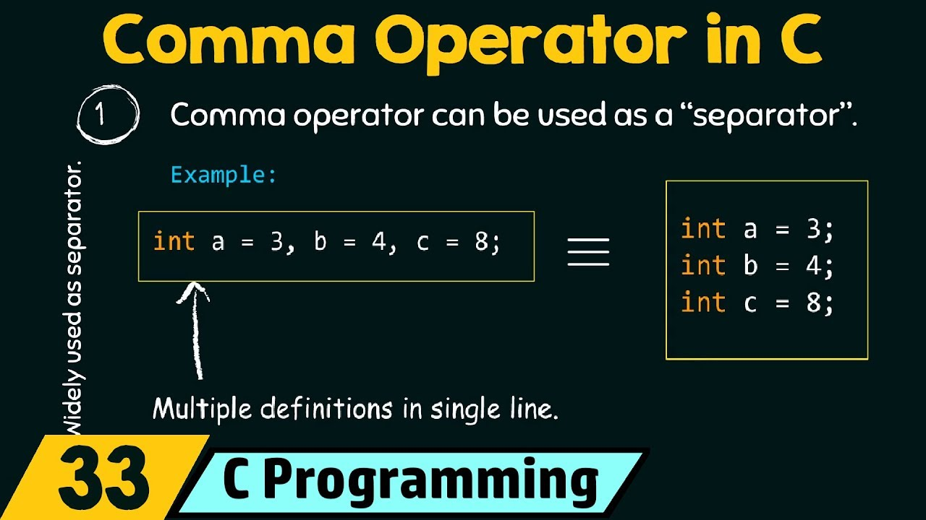

Slide 93
/**
* Commas act as separators in this line, not as an operator.
* Results: a=1, b=2, c=3, i=0
*/
int a=1, b=2, c=3, i=0;
/**
* Assigns value of b into i.
* Commas act as separators in the first line and as an operator in the second line.
* Results: a=1, b=2, c=3, i=2
int a=1, b=2, c=3;
int i = (a, b);
*/

Slide 94
If statement
The if in C is the most simple decision-making statement. It consists of the test condition and if block or body. If the given condition is true only then the if block will be executed.

Slide 95
Cont…
The if in C is a decision-making statement that is used to execute a block of code based on the value of the given expression. It is one of the core concepts of C programming and is used to include conditional code in our program

Slide 96
Syntax of if Statement in C
if(condition)
{
// if body
// Statements to execute if condition is true
}

Slide 97
// C Program to demonstrate the syntax of if statement
#include <stdio.h>
int main()
{
int gfg = 9;
// if statement with true condition
if (gfg < 10) {
printf("%d is less than 10", gfg);
}
// if statement with false condition
if (gfg > 20) {
printf("%d is greater than 20", gfg);
}
return 0;
}

Slide 98
if-else statement
The if-else statement in C programming is a fundamental control structure that allows a computer to execute certain code blocks based on specific conditions.
This conditional logic is crucial for creating dynamic and responsive programs, guiding the program flow based on user input or other data.

Slide 99
Cont…
The else Statement
Use the else statement to specify a block of code to be executed if the condition is false.

Slide 100
Syntax
if (condition) { // block of code to be executed if the condition is true } else { // block of code to be executed if the condition is false }

Slide 101
Example
int time = 20; if (time < 18) { printf("Good day."); } else { printf("Good evening."); } // Outputs "Good evening."

Slide 102
Cont…
In the example above, time (20) is greater than 18, so the condition is false. Because of this, we move on to the else condition and print to the screen "Good evening". If the time was less than 18, the program would print "Good day".

Slide 103
The else if Statement
Use the else if statement to specify a new condition if the first condition is false.
Syntax
if (condition1) { // block of code to be executed if condition1 is true } else if (condition2) { // block of code to be executed if the condition1 is false and condition2 is true } else { // block of code to be executed if the condition1 is false and condition2 is false }

Slide 104
Example
int time = 22; if (time < 10) { printf("Good morning."); } else if (time < 20) { printf("Good day."); } else { printf("Good evening."); }

Slide 105
C Switch Statement
Instead of writing many if..else statements, you can use the switch statement.
The switch statement selects one of many code blocks to be executed:

Slide 106
Syntax
switch (expression) { case x: // code block break; case y: // code block break; default: // code block }

Slide 107
This is how it works:
The switch expression is evaluated once
The value of the expression is compared with the values of each case
If there is a match, the associated block of code is executed
The break statement breaks out of the switch block and stops the execution
The default statement is optional, and specifies some code to run if there is no case match

Slide 108
Example
int day = 4; switch (day) { case 1: printf("Monday"); break; case 2: printf("Tuesday"); break; case 3: printf("Wednesday"); break; case 4: printf("Thursday"); break;
case 5: printf("Friday"); break; case 6: printf("Saturday"); break; case 7: printf("Sunday"); break; } // Outputs "Thursday" (day 4)

Slide 109
The break Keyword
When C reaches a break keyword, it breaks out of the switch block.
This will stop the execution of more code and case testing inside the block.
When a match is found, and the job is done, it's time for a break. There is no need for more testing.
A break can save a lot of execution time because it "ignores" the execution of all the rest of the code in the switch block.

Slide 110
C While Loop
Loops
Loops can execute a block of code as long as a specified condition is reached.
Loops are handy because they save time, reduce errors, and they make code more readable.

Slide 111
Cont…
The while loop loops through a block of code as long as a specified condition is true:
Syntax
while (condition) { // code block to be executed }

Slide 112
Cont…
In the example below, the code in the loop will run, over and over again, as long as a variable (i) is less than 5:

Slide 113
Example
int i = 0; while (i < 5) { printf("%d\n", i); i++; }
Note: Do not forget to increase the variable used in the condition (i++), otherwise the loop will never end!

Slide 114
C Do/While Loop
The do/while loop is a variant of the while loop. This loop will execute the code block once, before checking if the condition is true, then it will repeat the loop as long as the condition is true.

Slide 115
Syntax
do { // code block to be executed } while (condition);

Slide 116
Cont…
The example below uses a do/while loop. The loop will always be executed at least once, even if the condition is false, because the code block is executed before the condition is tested:

Slide 117
Example
int i = 0; do { printf("%d\n", i); i++; } while (i < 5);
Do not forget to increase the variable used in the condition, otherwise the loop will never end!

Slide 118
Real-Life Examples
To demonstrate a practical example of the while loop, we have created a simple "countdown" program:
int countdown = 3; while (countdown > 0) { printf("%d\n", countdown); countdown--; } printf("Happy New Year!!\n");

Slide 119
Cont…
In this example, we create a program that only print even numbers between 0 and 10 (inclusive):
Example
int i = 0; while (i <= 10) { printf("%d\n", i); i += 2; }

Slide 120
C For Loop
When you know exactly how many times you want to loop through a block of code, use the for loop instead of a while loop:

Slide 121
Syntax
for (expression 1; expression 2; expression 3) { // code block to be executed }
Expression 1 is executed (one time) before the execution of the code block.
Expression 2 defines the condition for executing the code block.
Expression 3 is executed (every time) after the code block has been executed.

Slide 122
Example
int i; for (i = 0; i < 5; i++) { printf("%d\n", i); }

Slide 123
Example explained
Expression 1 sets a variable before the loop starts (int i = 0).
Expression 2 defines the condition for the loop to run (i must be less than 5). If the condition is true, the loop will start over again, if it is false, the loop will end.
Expression 3 increases a value (i++) each time the code block in the loop has been executed.

Slide 124
break statement
You have already seen the break statement used in an earlier chapter of this tutorial. It was used to "jump out" of a switch statement.
The break statement can also be used to jump out of a loop.
This example jumps out of the for loop when i is equal to 4:

Slide 125
Example
int i; for (i = 0; i < 10; i++) { if (i == 4) { break; } printf("%d\n", i); }
In a looping statement, the break command ends the loop and moves control to the next command outside the loop

Slide 126
Continue
The continue statement breaks one iteration (in the loop), if a specified condition occurs, and continues with the next iteration in the loop.
This example skips the value of 4:

Slide 127
Example
int i; for (i = 0; i < 10; i++) { if (i == 4) { continue; } printf("%d\n", i); }

Slide 128
Break and Continue in While Loop
Break and Continue in While Loop
int i = 0; while (i < 10) { if (i == 4) { break; } printf("%d\n", i); i++; }

Slide 129
Continue Example
int i = 0; while (i < 10) { if (i == 4) { i++; continue; } printf("%d\n", i); i++; }

Slide 130
goto Statement in C
The C goto statement is a jump statement which is sometimes also referred to as an unconditional jump statement. The goto statement can be used to jump from anywhere to anywhere within a function.

Slide 131
Syntax:
Syntax1 | Syntax2
----------------------------
goto label; | label:
. | .
. | .
. | .
label: | goto label;

Slide 132
Cont…
In the above syntax, the first line tells the compiler to go to or jump to the statement marked as a label. Here, the label is a user-defined identifier that indicates the target statement.
The statement immediately followed after ‘label:’ is the destination statement. The ‘label:’ can also appear before the ‘goto label;’ statement in the above syntax.

Slide 133
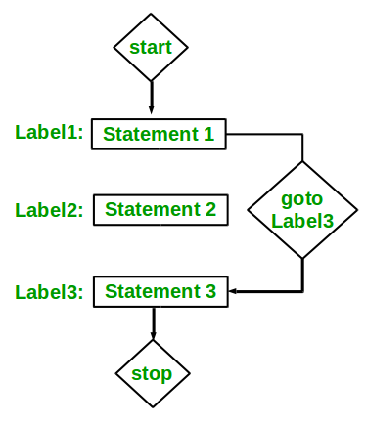

Slide 134
Examples:
Type 1: In this case, we will see a situation similar to as shown in Syntax1 above. Suppose we need to write a program where we need to check if a number is even or not and print accordingly using the goto statement. The below program explains how to do this:

Slide 135
// C program to check if a number is
// even or not using goto statement
#include <stdio.h>
// function to check even or not
void checkEvenOrNot(int num)
{
if (num % 2 == 0)
// jump to even
goto even;
else
// jump to odd
goto odd;
even:
printf("%d is even", num);
// return if even
return;
odd:
printf("%d is odd", num);
}
int main()
{
int num = 26;
checkEvenOrNot(num);
return 0;
}

Slide 136
Exercise:
Stop the loop if i is 5.
for (int i = 0; i < 10; i++) {
if (i == 5) {
??????
;
}
printf("%d\n", i);
}

Slide 137
Cont…
Type 2: In this case, we will see a situation similar to as shown in Syntax2 above. Suppose we need to write a program that prints numbers from 1 to 10 using the goto statement. The below program explains how to do this.

Slide 138
C program to print numbers
// from 1 to 10 using goto statement
#include <stdio.h>
// function to print numbers from 1 to 10
void printNumbers()
{
int n = 1;
label:
printf("%d ", n);
n++;
if (n <= 10)
goto label;
}
// Driver program to test above function
int main()
{
printNumbers();
return 0;
}
Output: 1 2 3 4 5 6 7 8 9 10

Slide 139
Disadvantages of Using goto Statement
The use of the goto statement is highly discouraged as it makes the program logic very complex.
The use of goto makes tracing the flow of the program very difficult.

Slide 140
Cont…
The use of goto makes the task of analyzing and verifying the correctness of programs (particularly those involving loops) very difficult.
The use of goto can be simply avoided by using break and continue statements.

Slide 141
Nested Loops
It is also possible to place a loop inside another loop. This is called a nested loop.
The "inner loop" will be executed one time for each iteration of the "outer loop":

Slide 142
Example
#include<stdio.h>
main(){
int i, j;
for(j=1;j<=6; j++){
for(i=1;i<=5; i++){
printf("*");
}
printf("\n");
}
}

Slide 143
Example2
#include<stdio.h>
main(){
int i, j;
for(i=1;i<=4; i++){
for(j=1;j<=5; j++){
printf("%d", j);
}
printf("\n");
}
}

Slide 144
Example3
#include<stdio.h>
main(){
int i, j;
for(i=1;i<=4; i++){
for(j=1;j<=5; j++){
printf("%d", i);
}
printf("\n");
}
}

Slide 145
Example4
#include<stdio.h>
main(){
int i, j;
for(i=1;i<=5; i++){
for(j=5;j>=1; j--){
printf("%d", j);
}
printf("\n");
}
}

Slide 147
C Arrays
Arrays
Arrays are used to store multiple values in a single variable, instead of declaring separate variables for each value.
To create an array, define the data type (like int) and specify the name of the array followed by square brackets [].

Slide 148
Cont…
To insert values to it, use a comma-separated list inside curly braces, and make sure all values are of the same data type:
int myNumbers[] = {25, 50, 75, 100};
We have now created a variable that holds an array of four integers.

Slide 149
Example
int myNumbers[] = {25, 50, 75, 100}; printf("%d", myNumbers[0]); // Outputs 25

Slide 150
Change an Array Element
To change the value of a specific element, refer to the index number:
Example
myNumbers[0] = 33;

Slide 151
Example
int myNumbers[] = {25, 50, 75, 100}; myNumbers[0] = 33; printf("%d", myNumbers[0]); // Now outputs 33 instead of 25

Slide 152
Loop Through an Array
You can loop through the array elements with the for loop.
The following example outputs all elements in the myNumbers array:

Slide 153
Access the Elements of an Array
To access an array element, refer to its index number.
Array indexes start with 0: [0] is the first element. [1] is the second element, etc.
This statement accesses the value of the first element [0] in myNumbers:

Slide 154
Example
int myNumbers[] = {25, 50, 75, 100}; int i; for (i = 0; i < 4; i++) { printf("%d\n", myNumbers[i]); }

Slide 155
Set Array Size
Another common way to create arrays, is to specify the size of the array, and add elements later:
Example
// Declare an array of four integers: int myNumbers[4]; // Add elements myNumbers[0] = 25; myNumbers[1] = 50; myNumbers[2] = 75; myNumbers[3] = 100;

Slide 156
Cont…
Using this method, you should know the number of array elements in advance, in order for the program to store enough memory.
You are not able to change the size of the array after creation.

Slide 157
Avoid Mixing Data Types
It is important to note that all elements in an array must be of the same data type.
This means you cannot mix different types of values, like integers and floating point numbers, in the same array:
Example
int myArray[] = {25, 50, 75, 3.15, 5.99};

Slide 158
Strings in array
Strings are used for storing text/characters.
For example, "Hello World" is a string of characters.
Unlike many other programming languages, C does not have a String type to easily create string variables. Instead, you must use the char type and create an array of characters to make a string in C:
char greetings[] = "Hello World!";

Slide 159
Cont…
Note that you have to use double quotes ("").
To output the string, you can use the printf() function together with the format specifier %s to tell C that we are now working with strings:

Slide 160
Example
char greetings[] = "Hello World!"; printf("%s", greetings);

Slide 161
Access Strings
Since strings are actually arrays in C, you can access a string by referring to its index number inside square brackets []
This example prints the first character (0) in greetings:
Example
char greetings[] = "Hello World!"; printf("%c", greetings[0]);
Note that we have to use the %c format specifier to print a single character.

Slide 162
Modify Strings
To change the value of a specific character in a string, refer to the index number, and use single quotes:
Example
char greetings[] = "Hello World!"; greetings[0] = 'J'; printf("%s", greetings); // Outputs Jello World! instead of Hello World!

Slide 163
Loop Through a String
You can also loop through the characters of a string, using a for loop:
Example
char carName[] = "Volvo"; int i; for (i = 0; i < 5; ++i) { printf("%c\n", carName[i]); }

Slide 164
Another Way Of Creating Strings
In the examples above, we used a "string literal" to create a string variable. This is the easiest way to create a string in C.
You should also note that you can create a string with a set of characters. This example will produce the same result as the example in the beginning of this page:

Slide 165
Example
char greetings[] = {'H', 'e', 'l', 'l', 'o', ' ', 'W', 'o', 'r', 'l', 'd', '!', '\0'}; printf("%s", greetings);
Why do we include the \0 character at the end? This is known as the "null terminating character", and must be included when creating strings using this method. It tells C that this is the end of the string.

Slide 166
Differences
The difference between the two ways of creating strings, is that the first method is easier to write, and you do not have to include the \0 character.
You should note that the size of both arrays is the same: They both have 13 characters (space also counts as a character by the way), including the \0 character:

Slide 167
Example
char greetings[] = {'H', 'e', 'l', 'l', 'o', ' ', 'W', 'o', 'r', 'l', 'd', '!', '\0'}; char greetings2[] = "Hello World!"; printf("%lu\n", sizeof(greetings)); // Outputs 13 printf("%lu\n", sizeof(greetings2)); // Outputs 13

Slide 168
Example
char message[] = "Good to see you,"; char fname[] = "John"; printf("%s %s!", message, fname);

Slide 169
What is an Array of Strings in C?
An array of strings is a two-dimensional array of character-type arrays where each character array (string) is null-terminated.
To declare a string, we use the statement
char string[] = {'H', 'e', 'l', 'l', 'o', '\0'};
Or
char string = "Hello";

Slide 170
Declare and Initialize an Array of Strings
To declare an array of strings, you need to declare a two-dimensional array of character types, where the first subscript is the total number of strings and the second subscript is the maximum size of each string.
To initialize an array of strings, you need to provide the multiple strings inside the double quotes separated by the commas.

Slide 171
Syntax
To construct an array of strings, the following syntax is used
char strings [no_of_strings] [max_size_of_each_string];
Example
Let us declare and initialize an array of strings to store the names of 10 computer languages, each with the maximum length of 15 characters.

Slide 172
char langs [10][15] = {
"PYTHON", "JAVASCRIPT", "PHP",
"NODE JS", "HTML", "KOTLIN", "C++",
"REACT JS", "RUST", "VBSCRIPT"
};

Slide 173
Printing An Array of Strings
A string can be printed using the printf() function with %s format specifier. To print each string of an array of strings, you can use the for loop till the number of strings.

Slide 174
Example
In the following example, we are declaring, initializing, and printing an array of string
#include <stdio.h>
int main (){
char langs [10][15] = {
"PYTHON", "JAVASCRIPT", "PHP",
"NODE JS", "HTML", "KOTLIN", "C++",
"REACT JS", "RUST", "VBSCRIPT"
};
for (int i = 0; i < 10; i++){
printf("%s\n", langs[i]);
}
return 0;
}

Slide 175
String Functions
C also has many useful string functions, which can be used to perform certain operations on strings.
To use them, you must include the <string.h> header file in your program:
#include <string.h>

Slide 176
String Length
For example, to get the length of a string, you can use the strlen() function
Example
char alphabet[] = "ABCDEFGHIJKLMNOPQRSTUVWXYZ"; printf("%d", strlen(alphabet));

Slide 177
Cont…
In the Strings chapter, we used sizeof to get the size of a string/array. Note that sizeof and strlen behaves differently, as sizeof also includes the \0 character when counting

Slide 178
Example
char alphabet[] = "ABCDEFGHIJKLMNOPQRSTUVWXYZ"; printf("%d", strlen(alphabet)); // 26 printf("%d", sizeof(alphabet)); // 27

Slide 179
Cont…
It is also important that you know that sizeof will always return the memory size (in bytes), and not the actual string length
Example
char alphabet[50] = "ABCDEFGHIJKLMNOPQRSTUVWXYZ"; printf("%d", strlen(alphabet)); // 26 printf("%d", sizeof(alphabet)); // 50

Slide 180
Concatenate Strings
To concatenate (combine) two strings, you can use the strcat() function
Example
char str1[20] = "Hello "; char str2[] = "World!"; // Concatenate str2 to str1 (result is stored in str1) strcat(str1, str2); // Print str1 printf("%s", str1);
Note that the size of str1 should be large enough to store the result of the two strings combined

Slide 181
Compare Strings
To compare two strings, you can use the strcmp() function.
It returns 0 if the two strings are equal, otherwise a value that is not 0:

Slide 182
Example
char str1[] = "Hello"; char str2[] = "Hello"; char str3[] = "Hi"; // Compare str1 and str2, and print the result printf("%d\n", strcmp(str1, str2)); // Returns 0 (the strings are equal) // Compare str1 and str3, and print the result printf("%d\n", strcmp(str1, str3)); // Returns -4 (the strings are not equal)

Slide 183
C Memory Address
When a variable is created in C, a memory address is assigned to the variable.
The memory address is the location of where the variable is stored on the computer.
When we assign a value to the variable, it is stored in this memory address.
To access it, use the reference operator (&), and the result represents where the variable is stored

Slide 184
Example
int myAge = 43; printf("%p", &myAge); // Outputs 0x7ffe5367e044
Note: The memory address is in hexadecimal form (0x..). You will probably not get the same result in your program, as this depends on where the variable is stored on your computer.

Slide 185
Cont…
You should also note that &myAge is often called a "pointer". A pointer basically stores the memory address of a variable as its value. To print pointer values, we use the %p format specifier.

Slide 186
C Pointers
Creating Pointers
We can get the memory address of a variable with the reference operator &

Slide 187
Example
int myAge = 43; // an int variable printf("%d", myAge); // Outputs the value of myAge (43) printf("%p", &myAge); // Outputs the memory address of myAge (0x7ffe5367e044)

Slide 188
A pointer is a variable that stores the memory address of another variable as its value.
A pointer variable points to a data type (like int) of the same type, and is created with the * operator.
The address of the variable you are working with is assigned to the pointer

Slide 189
Example
int myAge = 43; // An int variable int* ptr = &myAge; // A pointer variable, with the name ptr, that stores the address of myAge // Output the value of myAge (43) printf("%d\n", myAge); // Output the memory address of myAge (0x7ffe5367e044) printf("%p\n", &myAge); // Output the memory address of myAge with the pointer (0x7ffe5367e044) printf("%p\n", ptr);

Slide 190
Example explained
Create a pointer variable with the name ptr, that points to an int variable (myAge). Note that the type of the pointer has to match the type of the variable you're working with (int in our example).
Use the & operator to store the memory address of the myAge variable, and assign it to the pointer.
Now, ptr holds the value of myAge's memory address.

Slide 193
Defining a function
A function is a block of code which only runs when it is called.
You can pass data, known as parameters, into a function.
Functions are used to perform certain actions, and they are important for reusing code: Define the code once, and use it many times.

Slide 194
Predefined Functions
Predefined functions in C, also known as built-in functions or standard library functions, are functions that are already provided by the C programming language itself or by standard libraries. We include the math. h library to access mathematical functions like sqrt(), abs(), pow(), ceil(), and floor().

Slide 195
Cont…
For example, main() is a function, which is used to execute code, and printf() is a function; used to output/print text to the screen
Example
int main() { printf("Hello World!"); return 0; }

Slide 196
Create a Function
To create (often referred to as declare) your own function, specify the name of the function, followed by parentheses () and curly brackets {}
Syntax
void myFunction() { // code to be executed }

Slide 197
Example Explained
myFunction() is the name of the function
Void means that the function does not have a return value. You will learn more about return values later in the next chapter
Inside the function (the body), add code that defines what the function should do

Slide 198
Call a Function
Declared functions are not executed immediately. They are "saved for later use", and will be executed when they are called.
To call a function, write the function's name followed by two parentheses () and a semicolon ;
In the following example, myFunction() is used to print a text (the action), when it is called:

Slide 199
Example Inside main, call myFunction():
// Create a function void myFunction() { printf("I just got executed!"); } int main() { myFunction(); // call the function return 0; } // Outputs "I just got executed!"

Slide 200
A function can be called multiple times:
Example
void myFunction() { printf("I just got executed!"); } int main() { myFunction(); myFunction(); myFunction(); return 0; } // I just got executed! // I just got executed! // I just got executed!

Slide 201
Calculate the Sum of Numbers
You can put almost whatever you want inside a function. The purpose of the function is to save the code, and execute it when you need it.
Like in the example below, we have created a function to calculate the sum of two numbers. Whenever you are ready to execute the function (and perform the calculation), you just call it:

Slide 202
Example
void calculateSum() { int x = 5; int y = 10; int sum = x + y; printf("The sum of x + y is: %d", sum); } int main() { calculateSum(); // call the function return 0; } // Outputs The sum of x + y is: 15

Slide 203
C Function Parameters
Parameters and Arguments
Information can be passed to functions as a parameter. Parameters act as variables inside the function.
Parameters are specified after the function name, inside the parentheses. You can add as many parameters as you want, just separate them with a comma:

Slide 204
Syntax
returnType functionName(parameter1, parameter2, parameter3) { // code to be executed }

Slide 205
Cont…
In the example below, the function takes a string of characters with name as parameter. When the function is called, we pass along a name, which is used inside the function to print "Hello" and the name of each person:

Slide 206
Example
void myFunction(char name[]) { printf("Hello %s\n", name); } int main() { myFunction("Liam"); myFunction("Jenny"); myFunction("Anja"); return 0; } // Hello Liam // Hello Jenny // Hello Anja

Slide 207
Uses of pointers

